Slide 1

Text Mining – Deep Learning
Project presentation

Slide 2
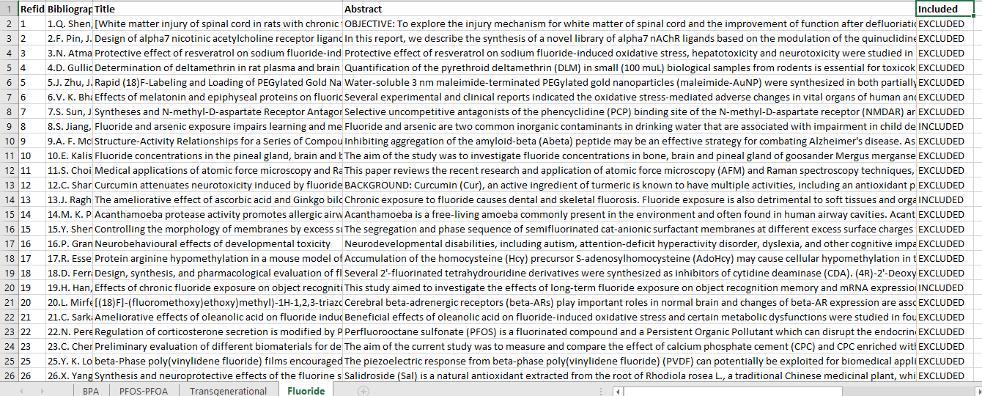
Application of deep learning-based text classification models
Data
Write abstract text into text documents
Create folders for both included & excluded abstract text

Slide 3
Data preparation
Separation of data into training and testing sets
Training set = 90%
Testing set = 10%

Slide 4
Data preparation
Load and cleaning the data
Split tokens on white space
Remove all punctuation from words
Remove all words that are not purely comprised of alphabetical
Set all text to lower case
Remove all stop words
Remove all words that have a length of equal or less than one character

Slide 5
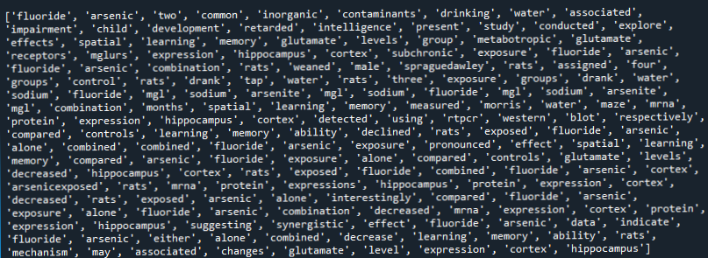
Data preparation
Output after cleaning our data

Slide 6
Data preparation
Defining a vocabulary of preferred words
Apply the data cleaning process to the text documents in both folders
Build a set of all known words
Develop a vocabulary as a COUNTER
A counter is a dictionary mapping of words

Slide 7
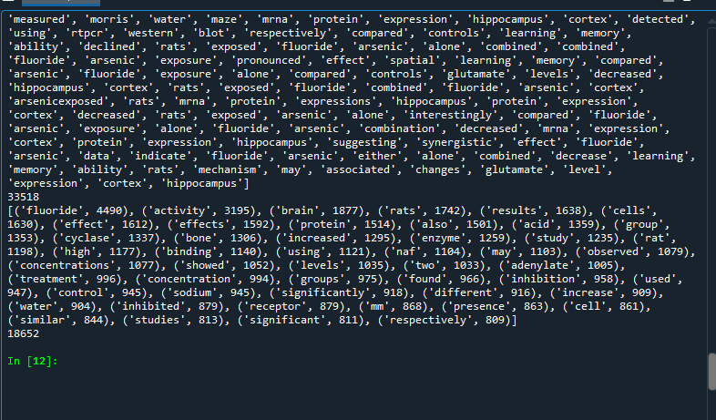
Data preparation
Defining a vocabulary of preferred words
Remove all words that have a low occurrence
Reduced word count from 33518 to 18652

Slide 8
Save the Vocabulary
Save the vocabulary to a new file
Why ?
Later we can load and use to filter ‘text data‘ prior to encoding them for modeling
The file has one word per line

Slide 9
CNN MODEL
100-dimensional vector space
Parameters of the model
Input length = maximum document length
CNN configuration
32 filter
learned weights of the convolutions
Kernel size = 8
Width x height of the filter mask
Activation function = relu
f(x)=max(0,x)
The function returns 0 if it receives any negative input, but for any positive value x it returns that value back

Slide 10
CNN MODEL
Pooling layer , pool size of 2
Reduces the output of the convolution layer by half
Global max pooling layer
Performs down-sampling by computing the maximum of the height and width dimensions of the input.
Flatten layer
Collapses the spatial dimensions of the input into the channel dimension Global

Slide 11
CNN MODEL
Dense , size = 10
add a non-linearity property
Dense , output layer

Slide 12
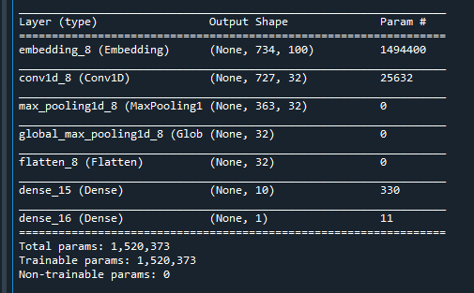
CNN MODEL
Output

Slide 13
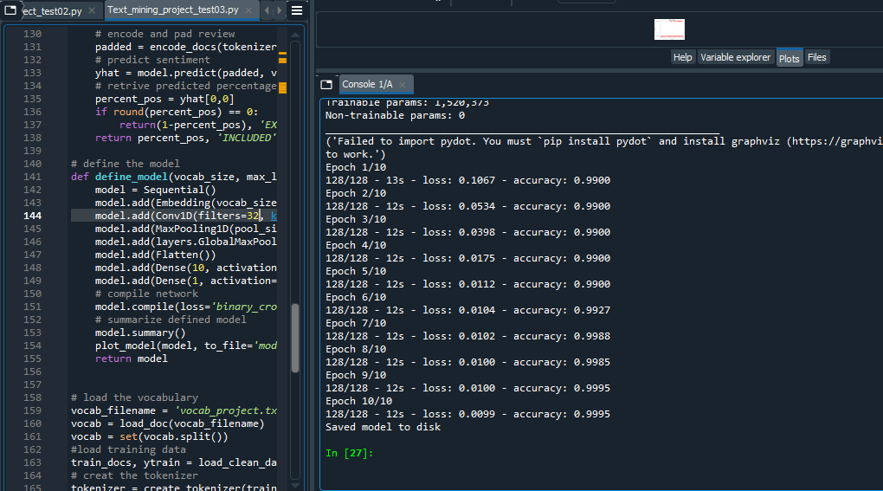
CNN MODEL
Model fitting with 10 epochs
Saved model to disk

Slide 14
Evaluate Model
Train Accuracy : 99.95
Test Accuracy : 97.715735

Slide 15
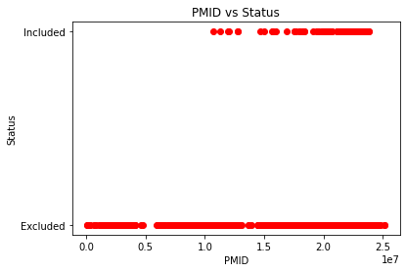
Conclusion
Some dataset are easy to get high accuracy on because the difference between classes is very high ,and maybe the model is directly optimizing for the loss and accuracy.

Slide 16
Thank you for your time

